Slide 1
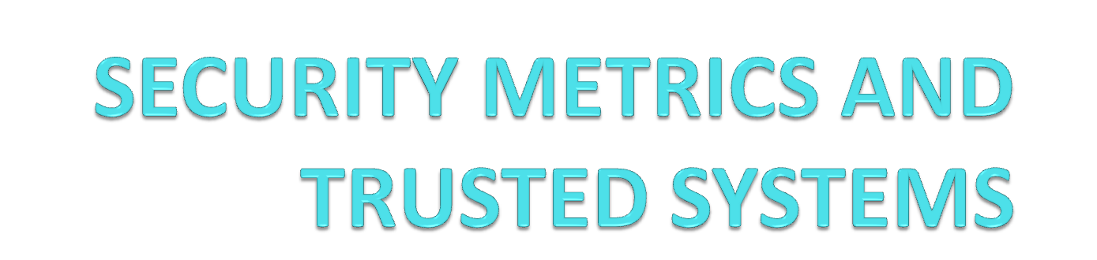

Slide 2
Measurements and metrics
Measure: A pure number
Metric: A ratio of two or more related measures.
Measurement is defined as the process of assigning symbols, usually numbers, to represent an attribute of the entity, by rule.
Metrics are the means of interpretation for the collected data.
A metric is defined as a standard of measurement using quantitative, statistical or mathematical analysis.

Slide 3
Security metrics
Measuring security is an important discipline in order to understand whether your security posture is improving or degrading and to understand if your security programs are having the desired effect.
Infosec metric is the application of quantitative, statistical or mathematical analysis to measure infosec functional trends and workload.
Metrics enable continuous improvement.

Slide 4
Security metrics classification
Security metrics model consists of 3 components:
  The object being measured
  The security objectives
  The method of measurement

Slide 5
Security objectives
Security objectives are divided into:
  Security requirements such as specifications, standards and control objectives and common criteria
  Best practices
  Security baselines
  Security management based on experience
  Maturity models such as SSE-CMM and Infosec assurance capability maturity model (IA-CMM).

Slide 6
Methods of measurement
Methods of measurement include the following:
  Direct testing
  Evaluation
  Assessment
  Training/education/level of competence
  Observation of system performance

Slide 7
Types of security metrics
Different types of security metrics that organizations can focus on can be:
  Business impact
    Business value gained/lost
    Acceptable loss estimate
  Program Results
    Timeliness of security service delivery
    Operational results
  Process implementation
    Level of implementation
    Implementation totality

Slide 8
Why security metrics are important
Identifying key risks within the organization
Targeting remediation/mitigation action
Measuring internal compliance with organizational policy
Discovering internal process breakdown
Taking advantage of security related sunk costs

Slide 9
Security models
Bell-LaPadula model
  Confidentiality
Biba model
  Integrity
Clark Wilson model
  Integrity

Slide 10
Terminology
Subjects
  Subjects are active
  Eg: Users/ Programs
Objects
  Objects are passive
  Eg: Files

Slide 11
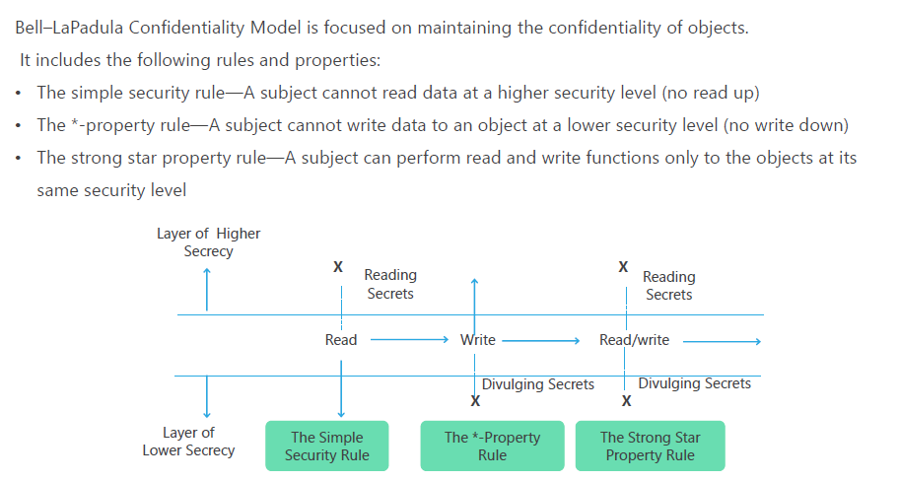
Bell-LaPadula Model

Slide 13
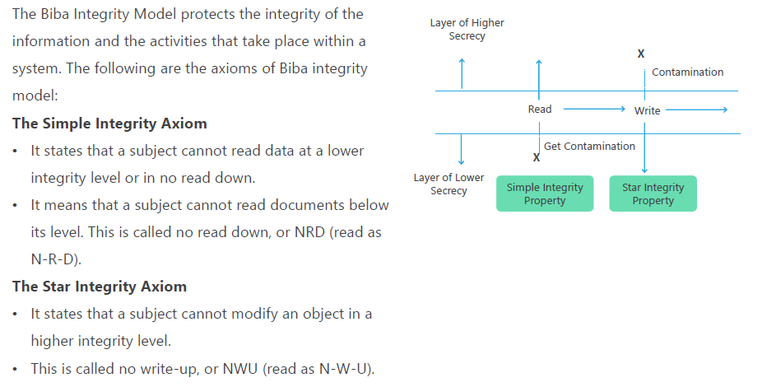
Biba model

Slide 15
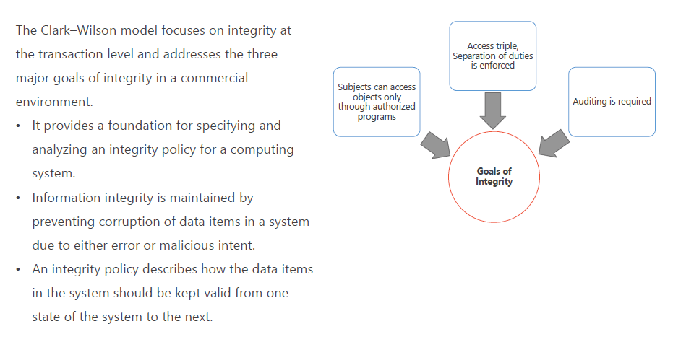
Clark Wilson Model

Slide 17
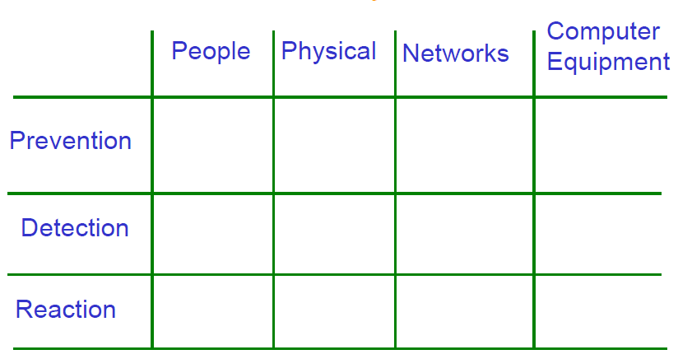
Security Matrix

Slide 18
The Security Matrix: uses
Use the matrix to focus measures where they are needed, and to be aware of what measures are being (purposely) neglected.
Drawing a threat/risk landscape. What areas are most at risk? Acceptable downtime.
Define future measures, baselines, or project specific security

Slide 19
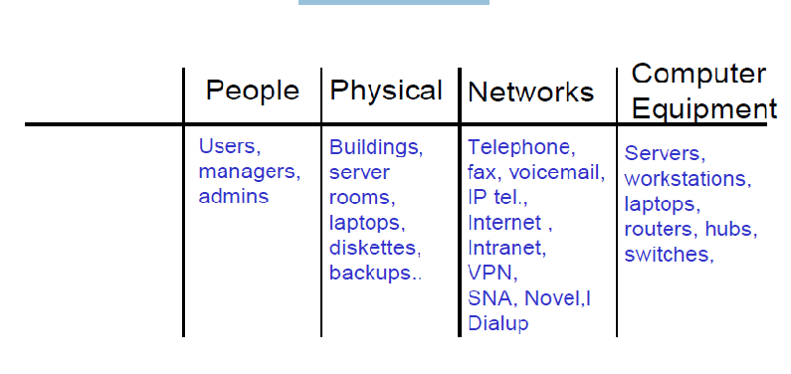
Examples

Slide 20
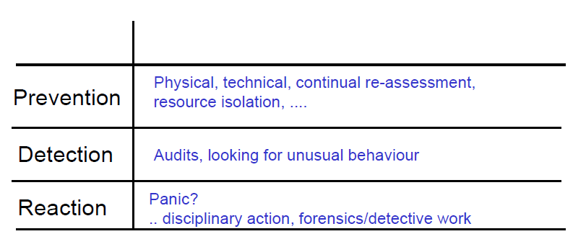
General measures

Slide 21
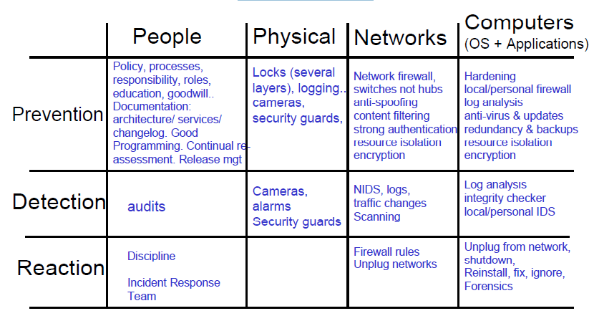
Measures

Slide 22
Computer Crime
Security and Privacy
Data communications capabilities provides new challenges
Keep data secure
Destruction
Accidental damage
Theft
Espionage
Keep data private
Salaries
Medical information
Social security numbers
Bank balances

Slide 23
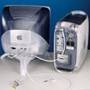
Ways to secure data
Locked servers
Removable hard drives that are locked when not in use
Hard disk drives requiring special tools for detachment
Physical cages around computers that prohibit access
Passwording files

Slide 24
Security
System of safeguards designed to protect a computer system and data from deliberate or accidental damage
Natural disasters
Fire
Accidents
Vandalism
Theft
Theft or destruction of data
Industrial espionage
Hackers

Slide 25
Security
Identification and Access
Provide access to authorized individuals only
Uses one of more of the following systems
  What you have
  What you know
  What you do
  What you are

Slide 26
Security
Identification and Access
What You Have
Key
Badge
Token
Plastic card – magnetized strip
Active badge – signals wearer’s location using infrared signals

Slide 27
Security
Identification and Access
What You Know
Password
Identification number
Combination

Slide 28
Security
Identification and Access
What You Do
Verify signature – software verifies scanned and online signatures

Slide 29
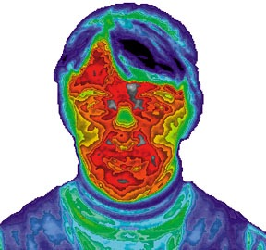
Security
Identification and Access
What You Are
Biometrics – science of measuring individual body characteristics
Fingerprints
Voice pattern
Retina of the eye
Entire face

Slide 30
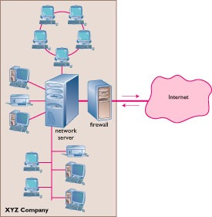
Security
The Internet
Firewall
  Dedicated computer that governs interaction between internal network and the Internet
Encryption
  Data Encryption Standard (DES)

Slide 31
Security
Personal Computers
Physical security with locks and cables
Surge protector
Uninterruptible power supply (UPS)
Backup files regularly and systematically

Slide 32
Privacy
Where is my data?
How is it used?
Who sees it?
Is anything private anymore?

Slide 33
Privacy
How Did They Get My Data?
Loans
Charge accounts
Orders via mail
Magazine subscriptions
Tax forms
Applications for schools, jobs, clubs
Insurance claim
Hospital stay
Sending checks
Fund-raisers
Advertisers
Warranties
Military draft registration
Court petition

Slide 34
Privacy
Your Boss is Spying on You!
Monitoring software
  Screens
  E-mail
  Keystrokes per minute
  Length of breaks
  What computer files are used and for how long

Slide 35
Privacy
Monitoring by Web Sites
Records:
City
Site you just left
Everything you do while on the site
Hardware and software you use
Click stream
  Series of clicks that link from site to site
  History of what the user chooses to view

Slide 36
Privacy
Monitoring by Web Sites
Cookie
Stores information about you
Located on your hard drive
Beneficial uses
  Viewing preferences
  Online shopping
  Secure sites retain password in cookie
Controversial use
  Tracking surfing habits for advertisers
Can set browser to refuse cookies or warn before storing
Software available to manage cookies

